Slide 1

The History of the English Language
From Old English to Global Dominance
Presented by: Susmay Das
Page
01

Slide 2
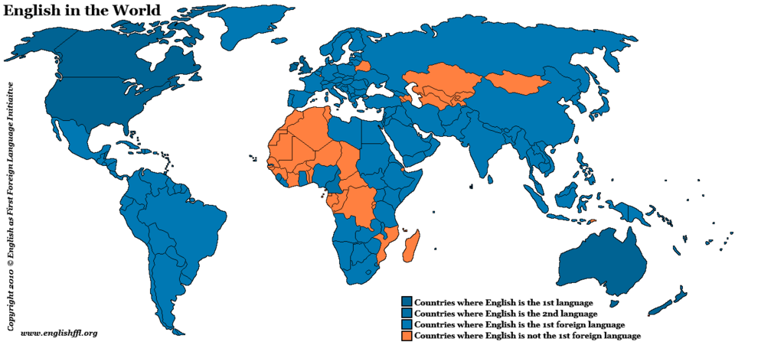
Why This Topic Matters
Spoken by 1.5+ billion people
Global language of science,
business, internet
Evolved from a tribal dialect
Page
02

Slide 3
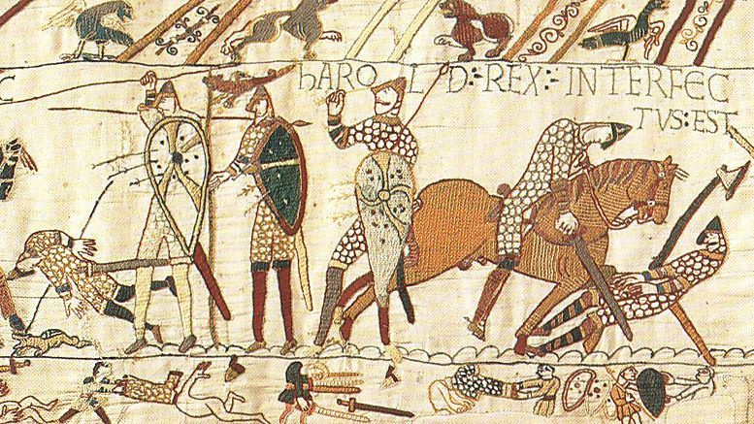
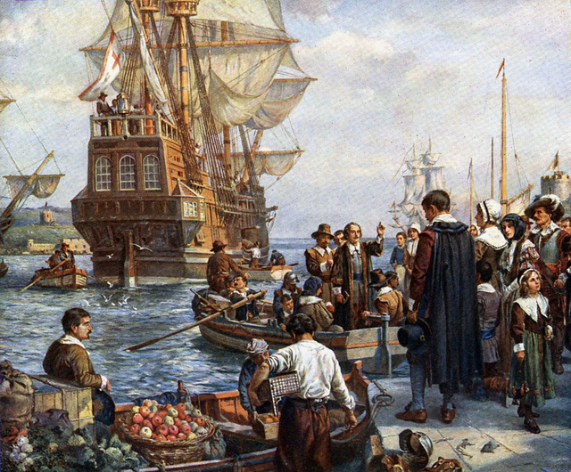
Timeline Overview
1. Old English (450–1100): Anglo-Saxon, Norse, Latin
2. Middle English (1100–1500): Norman French, simplified grammar
3. Early Modern (1500–1700): Printing press, Shakespeare
4. Modern English (1700–Now): Colonization, dictionaries
5. Global English: Internet, pop culture
Page
03

Slide 4
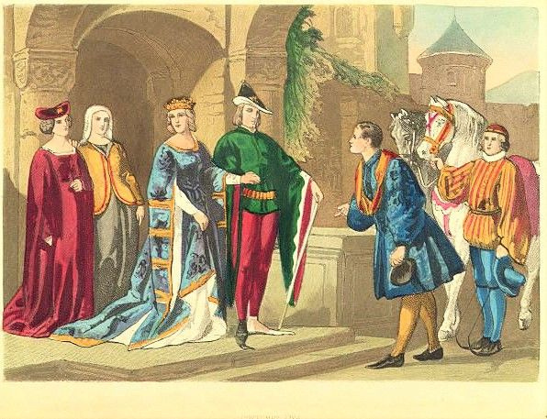
Key Historical Phases
Old English: Beowulf, Norse influence
Middle English:Chaucer, French vocab
Early Modern:Shakespeare, new words
Modern English:Industrial & tech terms
Page
04

Slide 5
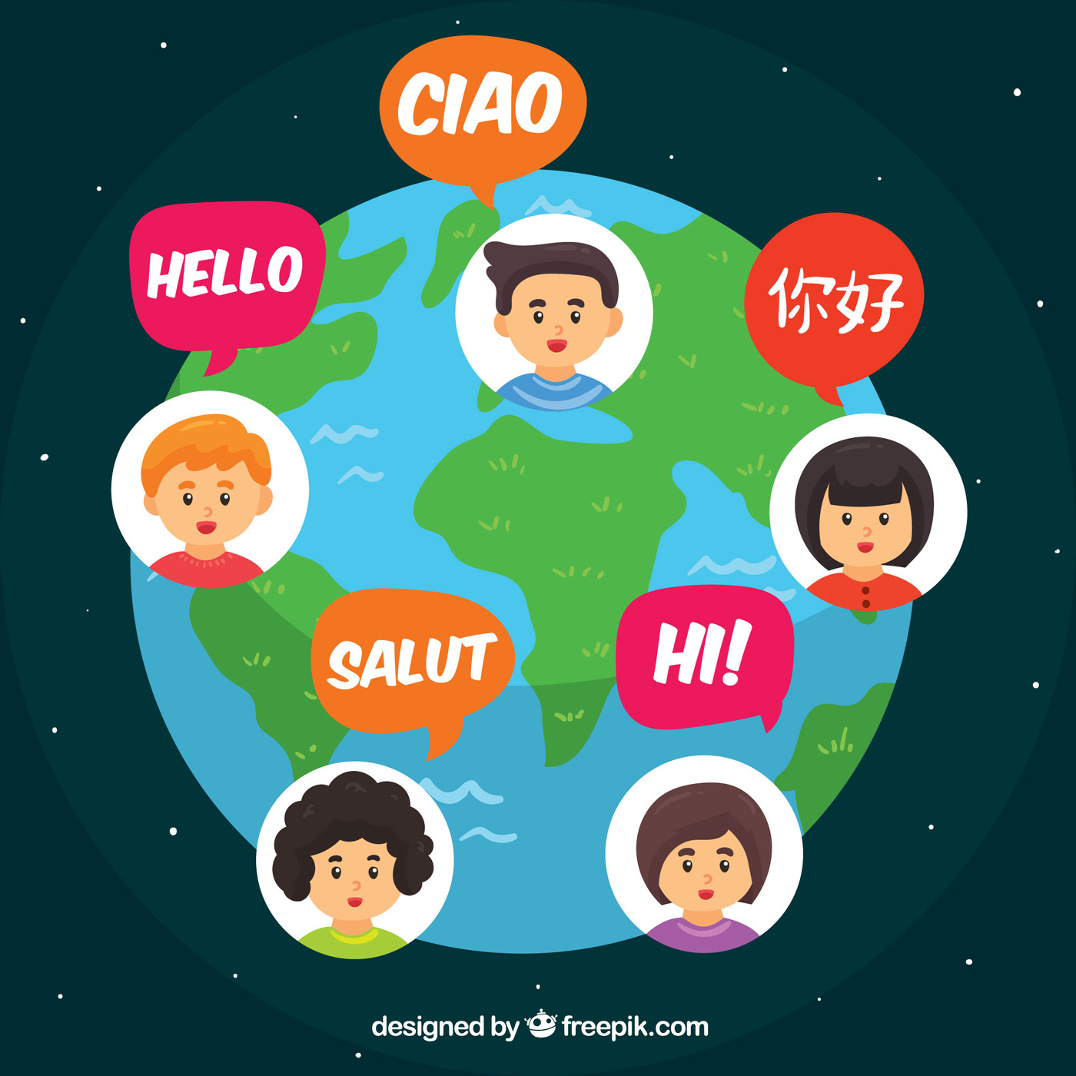
English Today — A Global Language
Spoken in 80+ countries
Variants: British, American, Indian, etc.
Shaped by pop culture, tech, internet
70% of internet content is in English
Page
05

Slide 6

Language Influences & Fun Words
Influences:
Old = Germanic/Latin/Norse
Middle = French
Modern = Global
Borrowed Words:
Ballet (French), Ketchup (Chinese), Robot (Czech), Pajama (Persian)
Page
06

Slide 7
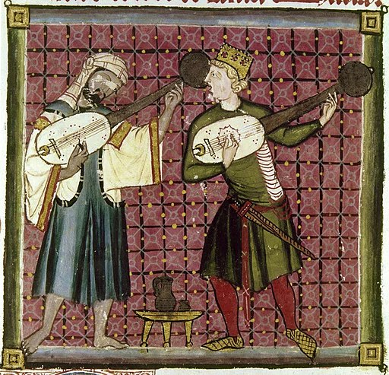
Conclusion
English evolved through invasion, culture, and communication
It’s flexible, dynamic, and still changing
Understanding its history helps us appreciate its depth
Page
07

Slide 8
Thank
You.
Any questions or comments?
Page
08

